Slide 2
Prototyping Model
The Prototyping Model is one of the most popularly used Software Development Life Cycle Models (SDLC models).
This model is used when the customers do not know the exact project requirements beforehand.
In this model, a prototype of the end product is first developed, tested, and refined as per customer feedback repeatedly till a final acceptable prototype is achieved which forms the basis for developing the final product.

Slide 3
Prototype Model
The basic idea here is that instead of freezing the requirements before design or coding can proceed, a throwaway prototype is built to understand the
This prototype is developed based on the currently known
By using this prototype, the client can get an “actually feel” of the system, since the interactions with prototype can enable the client to better understand the requirements of the desired
Prototyping is an attractive idea for complicated and large systems for which there is no manual process or existing system to help to determine the
The prototype are usually not complete systems and many of the details are not built in the prototype. The goal is to provide a system with overall functionality.

Slide 4
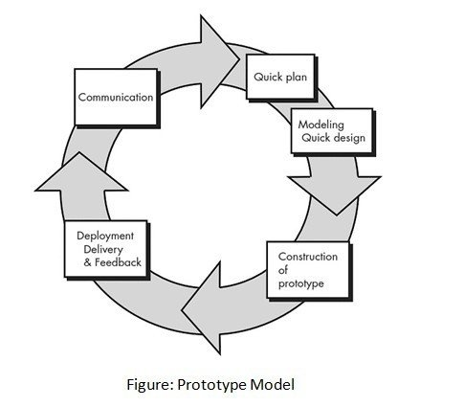

Slide 5
Prototype Model
is becoming a very popular software developing model as it enables to understand the customer requirement clearly and at an early stage of development.
Software prototyping refers to building a dummy model (it can be functional also) which displays the functionality of the system/software under development but it may not actually hold the exact logic of the original software.
A prototype is used for user evaluation of the system.

Slide 6
Advantages
Users are actively involved in the development
Since in this methodology a working model of the system is provided, the users get a better understanding of the system being
Errors can be detected much
Quicker user feedback is available leading to better
Missing functionality can be identified easily
Confusing or difficult functions can be identified

Slide 7
Disadvantages
Leads to implementing and then repairing way of building
Practically, this methodology may increase the complexity of the system as the scope of the system may expand beyond the original
An incomplete application may cause the application not to be used as the full system was designed.

Slide 8
Applications of Prototyping Model
The Prototyping Model should be used when the requirements of the product are not clearly understood or are unstable.
The prototyping model can also be used if requirements are changing quickly.
This model can be successfully used for developing user interfaces, high-technology software-intensive systems, and systems with complex algorithms and interfaces.
The prototyping Model is also a very good choice to demonstrate the technical feasibility of the product.

Slide 9
RAD (Rapid Application Development) Model
It is a type of incremental model. In the RAD model, the components or functions are developed in parallel as if they were mini
The developments are time-boxed, delivered, and then assembled into a working
This can quickly give the customer something to see and use and to provide feedback regarding the delivery and their requirements.
RAD model distributes the analysis, design, build and test phases into a series of short, iterative development cycles.

Slide 10
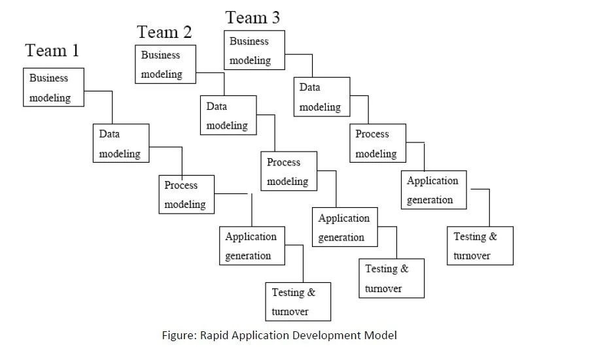

Slide 11
RAD Model
It is planned for a short duration of implementation & Delivery.
Most experienced programmers are involved in RAD Model.
In the incremental modal, the Application will be developed in a set of divided timelines called iterations, each iteration results in a deliverable product at the end.

Slide 12
Advantages
Reduced development
Increases reusability of components
Quick initial reviews occur
Encourages customer feedback
Integration from very beginning solves a lot of integration

Slide 13
Disadvantages
For large but scalable projects RAD requires sufficient human
Projects fail if developers and customers are not committed in a much-shortened time-frame.
Problematic if a system cannot be
Not appropriate when technical risks are high (heavy use of new technology).

Slide 14
When to use RAD Model?
When the system should need to create the project that modularizes in a short span time (2-3 months).
When the requirements are well-known.
When the technical risk is limited.
When there's a necessity to make a system, which modularized in 2-3 months of period.
It should be used only if the budget allows the use of automatic code generating tools.

Slide 15
Prototype Model | RAD Model
Using Prototype model, a product cannot be developed in short period of time as the requirements are refined in later prototypes. | Using the RAD approach, a product can be developed within very short period of time.
It can be used, even if the number of staff is less in the beginning. | It can be used, if sufficient number of staff is available.
In this approach, quick initial reviews are not possible. | In this approach, quick initial reviews are possible.
The prototype model approach is suitable for high risk projects. | The RAD model is not appropriate when technical risks are high.
It doesn’t support automatic code generation. | It results in minimal code writing as it supports automatic code generation.
User Involvement High. | User Involvement Only at the beginning.

Slide 16
Thank You

